Slide 1


Hands-On Notebook
Download Jupyter Notebook at:
https://tinyurl.com/llm-workshop-sgh
Sign in Google Colab with Google Account.

Slide 2

Harnessing the Power of LLM in Clinical Medicine Hands-On Session

Slide 3
Outline
1. Building Applications with LLM
2. Prompt Design
3. Case Studies & Hands-On Exercises
Extraction of Structured Data from Free Texts
Clinical Free Text Summarization
AI Assistant for Treatment Recommendations

Slide 4

Designing LLM Solutions

Slide 5
Common GPT applications
Data Extraction
Text Summarization
Questions Answering
Conversational Assistant Chatbot
Creativity
Code & Database Interactions
Autonomous Multi-Task Agent

Slide 6
LLM Interfaces
 | Web | Paid API | Open-Source models (Hugging Face)
Examples | ChatGPT, Bard | OpenAI GPT, Google PaLM-2, Claude-2 | Llama, Falcon GPT4All
Audience | General Public | Software Developers Data Scientists | Data Scientists Software Developers
PROS | User-friendly UI No coding required Free | Control of LLM Parameters Computations handled by API Distributors Low maintenance effort | Local storage Flexible & customizable (architecture, fine-tuning) Many open-source models available online
CONS | No control over LLM (aside from prompting) Difficult to scale & apply to more complex problems | Security & Data Privacy risks High operating (API) Cost | High initial cost Needs fine-tuning Additional engineering Model performance

Slide 7
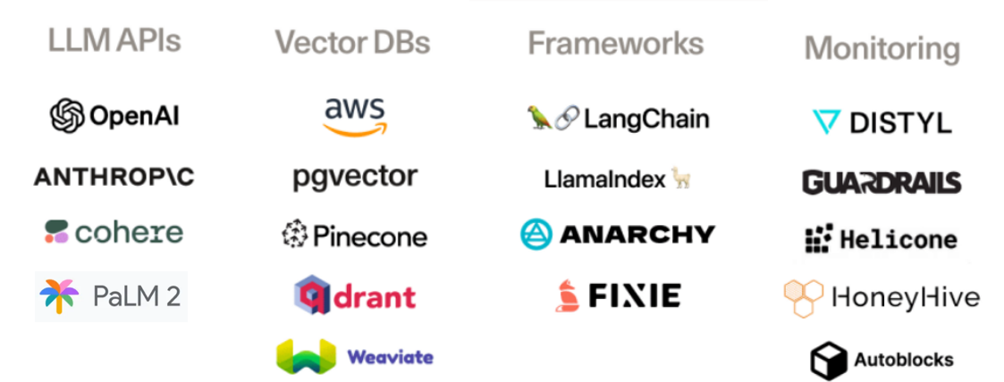
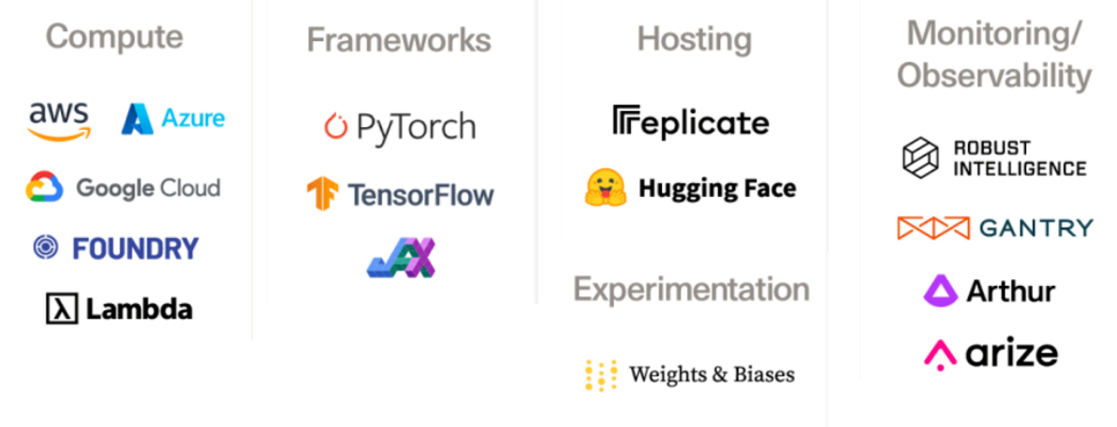
In-Context Learning | Fine-Tuning
No inner knowledge (weights) update
At inference, provide LLM with relevant knowledge via prompts
Main components:
LLM API
Knowledge Database
Update Inner Knowledge (weights) during training (fine-tune)
At inference, ask LLM to answer the question/execute tasks
No additional context info required

Slide 8

Prompts

Slide 9
Designing Prompts
Define LLM Behaviour
(System) AI Role
You are a helpful AI Assistant who does not harm people. You do not patients’ information in your answer.
Planning to tasks execution
(System) Instructions
Your task is to classify patients into risks level based on information given in contexts
Grounded Information
(System) Contexts
Patients below 25 years old have low risk, patients below 50 years old have medium risk and patients above 50 years old have high risk
Structure Output Format
(System) Output Instructions
Output your answer as a single word: Low, Medium or High
Few Shot Prompting Conversation Memory
(User & AI) Examples/History
Human: Patient is a 30-year-old man.
AI: Medium
HUMAN QUESTION
(User) Question
Human: 85-year-old patient
AI ANSWER
(AI) Answer

Slide 10
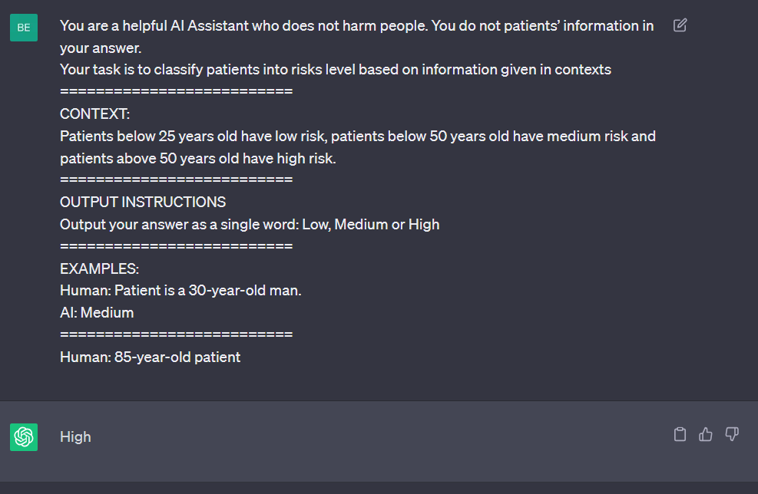
One/Few-Shot Prompting
Provide one or more examples of Question-Answer pairs
Reduce LLM hallucination & improve output consistency

Slide 11
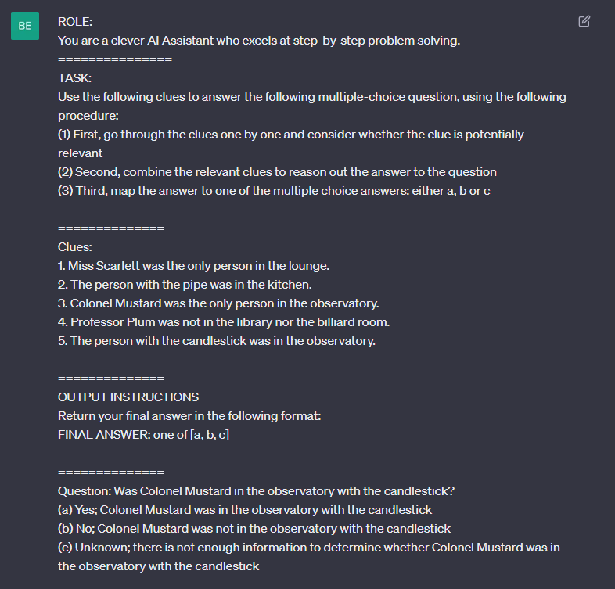
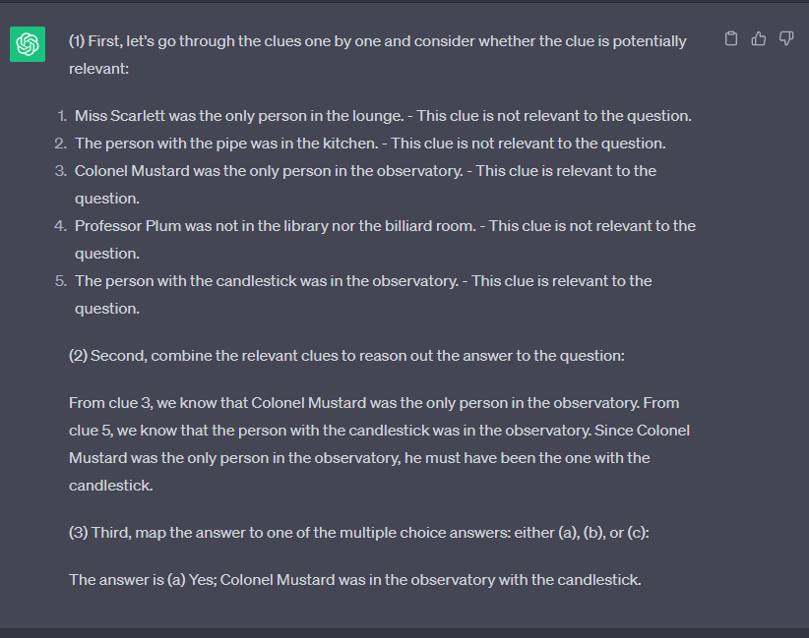
Chain-Of-Thought Prompting

Slide 12
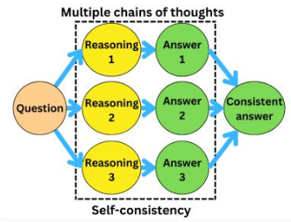
Self-Consistency Sampling
Ask GPT models the same question multiple times
Choose the most common answers (majority voting)
Self-Consistency Improves Chain of Thought Reasoning in Language Models
https://arxiv.org/abs/2203.11171

Slide 13

Hands-on Exercises
Download Jupyter Notebook at:
https://tinyurl.com/llm-workshop-sgh

Slide 14

Example 1
Extracting structured data from patient’s summaries

Slide 15
Structured Data Extraction
Age: 67
Ethnicity: Chinese
Gender: Female
Drug Allergy: NO
Smoking Status: NO
Drinking Status: NO
History of Diabetes: YES
History of Hypertension: YES
History of Heart Conditions: YES
Example: 67-year-old CHI lady NKDA non-smoker, non-drinker ADL independent, comm ambulant PMHx: 1) Diabetes mellitus, last HbA1c 5.8%, normal creatinine clearance, basline Cr normal 2) Hypertension F/U OPS 3) Prev S/B NHC for chest pain 4) Fe deficiency anemia Basline Hb ~10
Example: 67-year-old CHI lady NKDA non-smoker, non-drinker ADL independent, comm ambulant PMHx: 1) Diabetes mellitus, last HbA1c 5.8%, normal creatinine clearance, basline Cr normal 2) Hypertension F/U OPS 3) Prev S/B NHC for chest pain 4) Fe deficiency anemia Basline Hb ~10

Slide 16
Structured Data Extraction
Extract Information
Format Output
Free Text
LLM
Structured Text
Regex
Structured Object
67-year-old CHI lady NKDA non-smoker, non-drinker ADL independent, comm ambulant PMHx: 1) Diabetes mellitus, last HbA1c 5.8%, normal creatinine clearance, basline Cr normal 2) Hypertension F/U OPS 3) Prev S/B NHC for chest pain 4) Fe deficiency anemia Basline Hb ~10
“- Age: 67\n- Ethnicity: Chinese\n- Gender: Female\n- Drug Allergy: NO\n- Smoking Status: NO\n- Drinking Status: NO\n- History of Diabetes: YES\n- History of Hypertension: YES\n- History of Heart Conditions: YES”
{ Age: 67,
Ethnicity: Chinese,
Gender: Female,
Drug Allergy: NO,
Smoking Status: NO,
Drinking Status: NO,
History of Diabetes: YES,
History of Hypertension: YES,
History of Heart Conditions: YES}

Slide 17
Prompt
You are an honest medical officer.
If you don't know the answer, return None or "I don't know", don't try to make up an answer.
=========================
TASK: Analyse the given patient summary and extract the following information
- Age
- Ethnicity
- Gender
- Drug Allergy
- Smoking Status
- Drinking Status
- History of Diabetes
- History of Hypertension
- History of Heart Conditions
If the information is not present in the patient summary, return "NO"
(System) AI Role
EXAMPLES:
PATIENT PROFILE: 46 year old Chinese gentleman no known drug allergy ADL independent,
community ambulant walking stick smoker, 10 sticks/day; started 25 years ago Non-drinker Married,
Currently unemployed Past Medical History 1. Ischaemic Heart Disease ICD implanted for primary prevention
2. Parxoysmal AF - noted episodes of pAF and NSVT in Feb 2015 - subsequently commenced on amiodarone
4. Diabetes Mellitus - complicated by nephropathy - HbA1c -
6.2%. 5. Hypertension 6. Hyperlipidemia 7. Anaemia 8. Major Depressive Disorder
- diagnosed in 2016, - started on Fluvoxamine 25 mg ON - defaulted outpatient follow up.
ANSWER:
- Age: 46
- Ethnicity: Chinese
- Gender: Male
- Drug Allergy: NO
- Smoking Status: YES
- Drinking Status: NO
- History of Diabetes: YES
- History of Hypertension: YES
- History of Heart Conditions: YES
=======================
(System) Instructions
========================
OUTPUT INSTRUCTION:
Return your answer in the following format
- Age: Single Integer
- Ethnicity: One of [Chinese, Malay, Indian, Others]
- Gender: One of [MALE, FEMALE]
- Drug Allergy: One of [YES, NO]
- Smoking Status: One of [YES, NO]
- Drinking Status: One of [YES, NO]
- History of Diabetes: One of [YES, NO]
- History of Hypertension: One of [YES, NO]
- History of Heart Conditions: One of [YES, NO]
=======================
(System) Contexts
(System) Output Instructions
(User & AI) Examples/History
PATIENT PROFILE: 67 year old CHI lady NKDA non smoker, non drinker ADL independent, comm ambulant. PREV HIST: 1) Diabetes mellitus, last HbA1c 5.8%, normal creatinine clearance, basline Cr normal 2) Hypertension F/U OPS 3) Prev S/B NHC for chest pain 4) Fe deficiency anemia Basline Hb ~10
(User) Question

Slide 18

Example 2
Summarization of Clinical Consultations

Slide 19
Text Summarization
Patient Details: 55-year-old individual who is generally in good health. No previous history of similar symptoms or major health issues. The patient's father had colon cancer in his late 60s.
Current Symptoms: The patient has been experiencing sharp abdominal pain in the lower part of the abdomen for about two weeks. They have also noticed blood in their stool
Living Habits: Used to smoke but quit ten years ago. They consume alcohol socially and have a moderate intake. Have an unhealthy diet with frequent consumption of red meat and a lack of regular exercise.
Recommendation: Colonoscopy to investigate the possibility of polyps in the colon. If polyps are found, they can be removed during the procedure for biopsy. The removed polyps will be sent to the lab for analysis to determine their nature (benign, precancerous, or cancerous).
Doctor: Good morning, my name is Dr. Anderson. How can I assist you today?
Patient: Good morning, Doctor. I've been experiencing some abdominal pain lately, and I've noticed some blood in my stool. I'm quite worried about it.
Doctor: I understand. It's good that you've come to see me. Can you describe the pain you are feeling?
Patient: It's a kind of sharp pain that comes and goes. It's mainly in the lower part of my abdomen.
Doctor: And can you tell me how long this has been going on?
Patient: I'd say for about two weeks now.
Doctor: Okay, I see. I understand that this can be concerning. We'll get to the bottom of this. Now, I'm going to ask you a few questions to help me understand your situation better. May I know your age, please?
Patient: I'm 55 years old.
Doctor: Thank you. Are you currently taking any medications or do you have any known allergies?
Patient: No, I'm not on any medication. As for allergies, I'm allergic to penicillin.
Doctor: Noted. And have you previously had any similar symptoms or any major health issues?
Patient: No, this is the first time I'm experiencing something like this. I've generally been in good health.
Doctor: Alright. And how about your family history? Any known cases of gastrointestinal diseases, specifically colon cancer?
Patient: My father had colon cancer. He was diagnosed in his late 60s.
Doctor: I see. That's very important to know. Considering your age, symptoms, and family history, there's a chance that these symptoms could be related to polyps in the colon, benign growths that can sometimes lead to colon cancer. However, we need more information before jumping to conclusions.
Patient: That's quite worrying, doctor.
Doctor: I understand your concern, but please remember we are just considering possibilities at this stage. Let's continue with the questions. Do you smoke or consume alcohol?
Patient: I used to smoke but quit about ten years ago. I drink socially, maybe a glass of wine or two during the weekends.
Doctor: Good to hear you quit smoking. And your alcohol consumption seems moderate. How about your diet and physical activity? Do you consume a lot of red or processed meat? And do you have regular exercise?
Patient: I must admit my diet isn't the healthiest. I eat red meat quite often and don't exercise as much as I should.
Doctor: Okay, thank you for being honest. It's important to remember that a healthy diet and regular exercise can lower the risk of many diseases, including colon polyps. Now, based on your symptoms and the information you've provided, I would recommend a colonoscopy. This procedure will allow us to view the inside of your entire colon and rectum to check for any abnormalities.
...
Can we use LLM
to summarize?

Slide 20
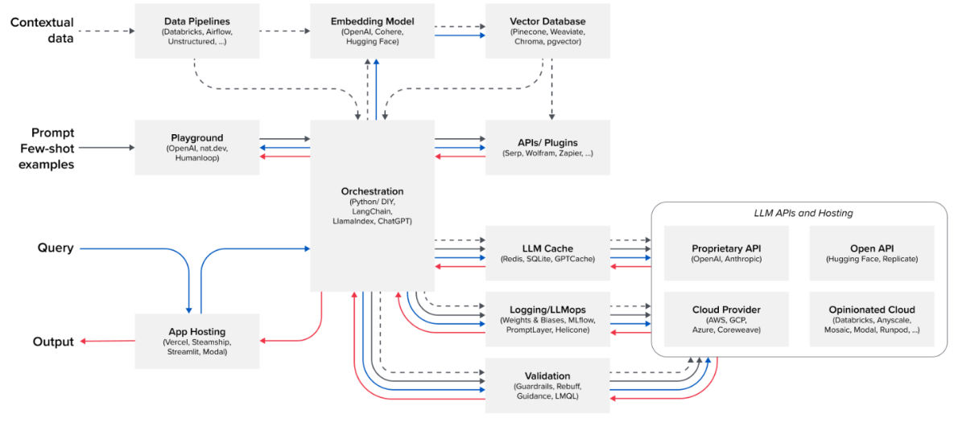
Langchain
A framework library for developing application backend on LLM
Integrate LLM with Databases, APIs, Tools, etc
Enable building LLM pipelines by connecting chains

Slide 21







Langchain Main Components
High Level
Components
Agents
Chains
Low Level
Components
Prompts
Memory
Tools
Databases
LLMs

Slide 22

Summarization Chain
Prompt Template
LLM
Prompt
Write a concise summary of the following:
{text}
CONCISE SUMMARY:
Summary
Documents

Slide 23
Custom Summary Prompt
You are an honest and detail-oriented AI Medical Assistant. If you do not know the answers, just say I don't know, do not make up an answer.
=========================
(System) AI Role
TASK: Your task is to summarize the conversation between the doctor and the patient for doctors' future refence for treatments/recommendations.
Note that your summary should be concise while including details on patients and treatments.
(System) Instructions
(System) Contexts
========================
OUTPUT INSTRUCTION: Your summary should include, if applicable:
- Patient's details such as age, gender, ethnicity
- Previous medical conditions, treatment and family member history
- Living habit such as eating, drinking, smoking
- Current Symptoms & Treatment recommended.
Keep your summary in fewer than 300 words.
=======================
(System) Output Instructions
(User & AI) Examples/History
(User) Question
CONVERSATION:
{text}
Documents stuffed into placeholder {text}

Slide 24
Token Limits
Input Tokens + Output Tokens <= Max Tokens
Model | Max Tokens | Input Price / 1k tokens | Output Price / 1k tokens
GPT-3.5 | 4096 | 0.0015 | 0.002
GPT-3.5-16k | 16384 | 0.003 | 0.004
GPT-4 | 8192 | 0.03 | 0.06
GPT-4-32k | 32768 | 0.06 | 0.12
Google PaLM-2 | 4096 | 0.0005 / 1k chars | 0.0005/ 1k chars
Claude-100k | 100000 | 0.011 | 0.032
Llama | 2048 | Open Source
Llama-2 | 4096 | Open Source
Falcon-40b | 2048 | Open Source

Slide 25
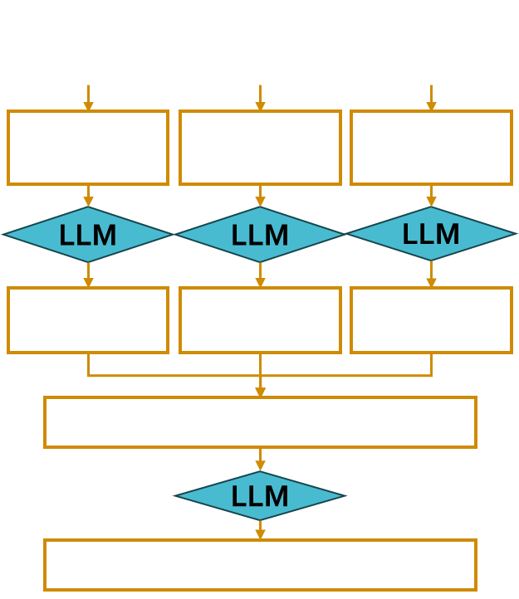
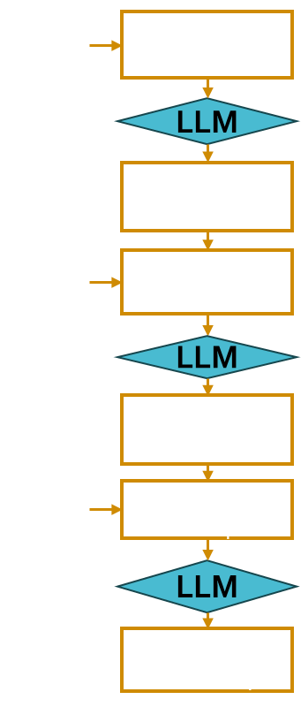
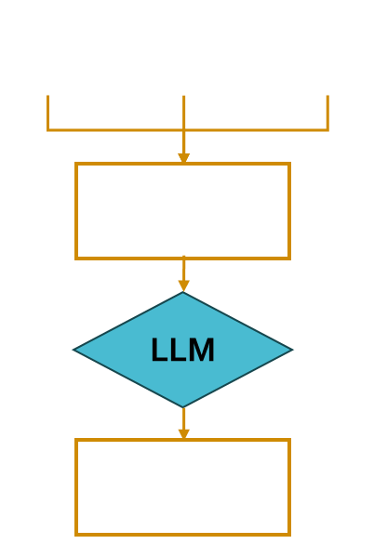
STUFF
REFINE
MAP REDUCE

Slide 26
Summarize Prompt
LLM
Summarize Prompt
Summarize Prompt
Summarize Prompt
Intermediate Summary
LLM
LLM
LLM
Refine Prompt
Summarize Prompt
Single Summary
Single Summary
Single Summary
LLM
LLM
Intermediate Summary
Combine Prompt
Refine Prompt
Final Summary
LLM
LLM
Final Summary
Final Summary

Slide 27

Use Case 3
Recommendation for patient treatments with guidelines reference

Slide 28
Providing LLMs with Contexts
Define LLM Behaviour
(System) AI Role
Planning to tasks execution
(System) Instructions
Given the Contexts, answer the question
Grounded Information
(System) Contexts
Information after cutoff dates
Structure Output Format
(System) Output Instructions
Few Shot Prompting Conversation Memory
(User & AI) Examples/History
HUMAN QUESTION
(User) Question
AI ANSWER
(AI) Answer

Slide 29
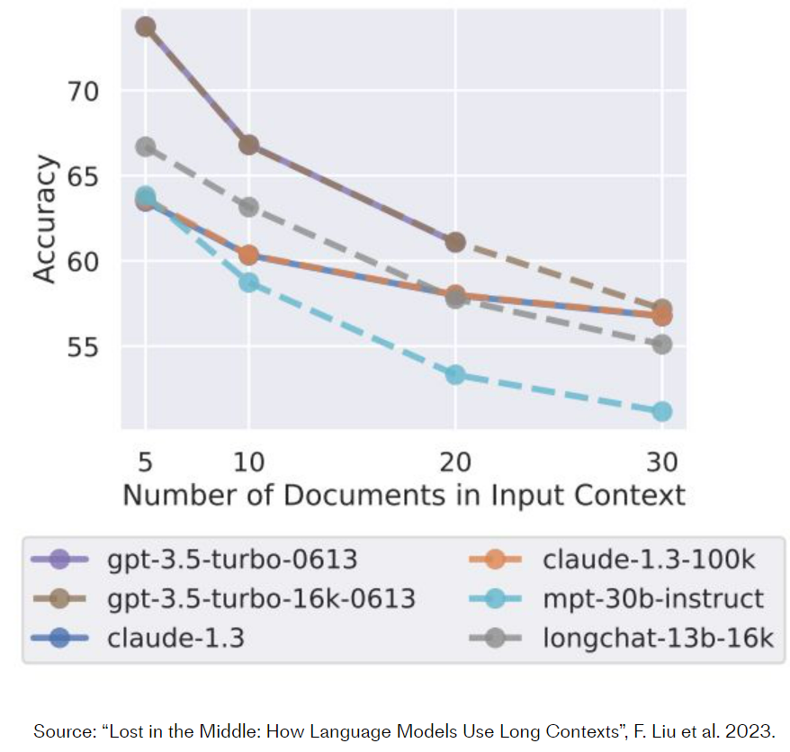
Why Retrieval Augmented Generation
LLM limited context length
Hallucinations
Tokens = $$$

Slide 30
Retrieval Augmented Generation (RAG)
Vector Database
KG Database
Knowledge Base
Extract Relevant Docs
Retriever
Context
Question
Prompt
LLM
Answer

Slide 31




Vector Database
“Dog”
Query
Convert Unstructured Data into vectors (index)
“chihuahua”
[0.1, 0.2, 0.5]
“puppy”
[0.3, 0.6, 0.8]
Store index -> content inside a vector database
[0.2, 0.5, 0.7]
Relevant Documents Search using KNN

Slide 32


How to build a Vector Database on documents
1
2
3
4
Collect Documents
Split into Small Chunks
Convert Text to Vectors with Embedding Model
Store inside Database

Slide 33


Retrieval QA Chain
Relevant Docs
Prompt Template
Prompt
Answer question
based on context:
CONTEXT:
{text}
QUESTION:
{question)
ANSWER:
Retriever
LLM
Answer

Slide 34
Custom Retrieval QA Prompt
You are an AI medical agent who provides recommendation for treatment of diseases. For patient safety, if you don’t know the answer, just say you don’t know, do not make up an answer
=========
(System) AI Role
TASK: Given the information given in CONTEXT and a question, create a final answer with references ("SOURCES").
=========
(System) Instructions
EXAMPLES:
CONTEXT:
Content: This Agreement is governed by English law and the parties submit to the exclusive jurisdiction of the English courts in relation to any dispute (contractual or non-contractual) concerning this Agreement save that either party may apply to any court for an injunction or other relief to protect its Intellectual Property Rights.
Source: 28-pl
Content: (b) if Google believes, in good faith, that the Distributor has violated or caused Google to violate any Anti-Bribery Laws (as defined in Clause 8.5) or that such a violation is reasonably likely to occur,
Source: 4-pl
QUESTION: Which state/country's law governs the interpretation of the contract?
FINAL ANSWER: This Agreement is governed by English law.
SOURCES: 28-pl
OUTPUT INSTRUCTION:
ALWAYS return a "SOURCES" part in your answer.
=======================
(System) Contexts
(System) Output Instructions
CONTEXT:
{summaries}
=========
Retrieved Documents stuffed into placeholder {summaries}
(User & AI) Examples/History
=======================
EXAMPLE
=========
QUESTION: {question}
FINAL ANSWER:
Input question into placeholder {question}
(User) Question

Slide 35
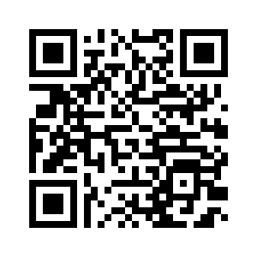
Thank you
Please kindly spare a few moments to share how we can improve our future workshop

Slide 36

Q & A

Slide 37
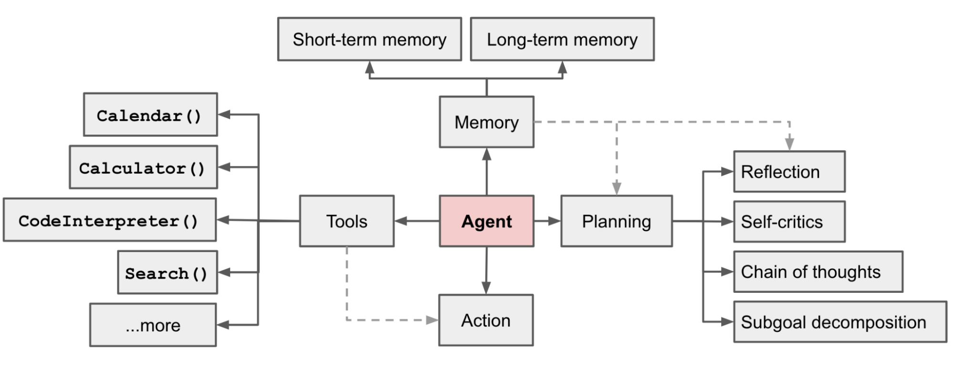

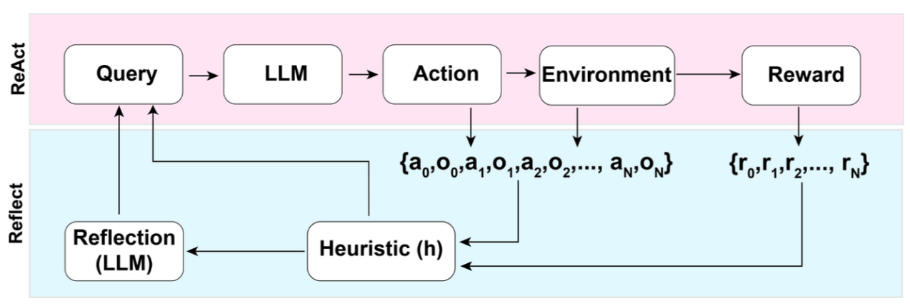
Agent
LLM as reasoning engine to plans and control which actions to take
Received feedback from environment to reflect and reformulate plans
https://www.latent.space/p/agents
Equipped with tools to extend LLM capabilities
Useful for tackling complex tasks which require many steps
Shinn & Labash, 2023 https://arxiv.org/abs/2303.11366

Slide 38
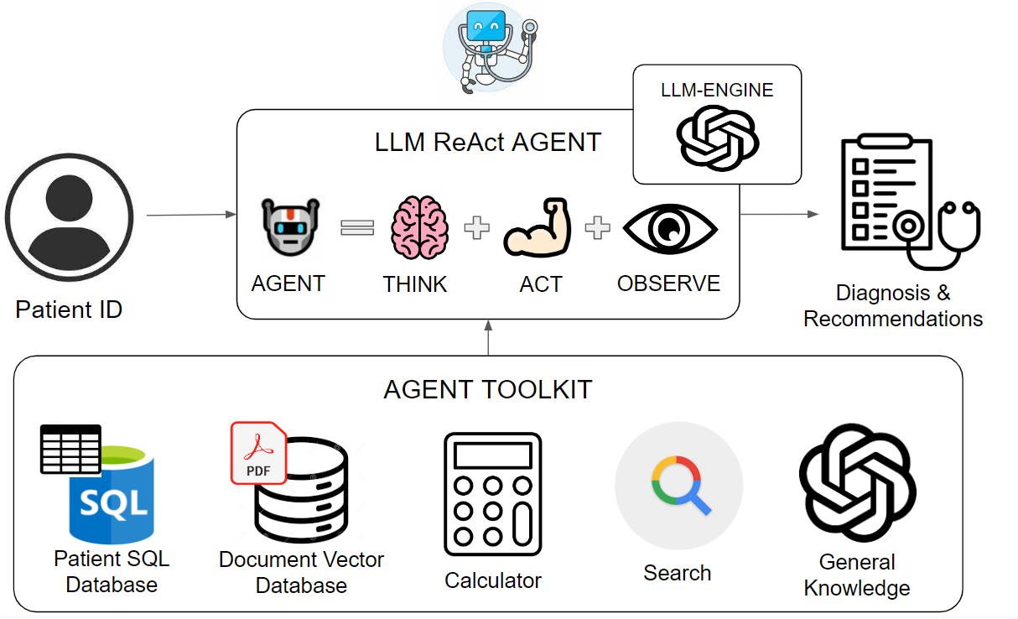
Example: Design Medical Assistant Agent

Slide 39

Agent Logic: Reason and Act (ReAct)
Answer the following questions as best you can. You have access to the following tools:
{tool descriptions}
Use the following format:
Question: the input question you must answer
Thought: you should always think about what to do
Action: the action to take, should be one of [{tool_names}]
Action Input: the input to the action
Observation: the result of the action
... (this Thought/Action/Action Input/Observation can repeat N times)
Thought: I now know the final answer
Final Answer: the final answer to the original input question
Begin!
Question: {input}
Thought:{agent_scratchpad}
Question
THINK
OBSERVE
Do you know the final answer?
NO
ACTION
YES
ANSWER
ReAct Framework: https://arxiv.org/abs/2205.00445

Slide 40

Agent Toolkit and Agent Tool Choices
Answer the following questions as best you can. You have access to the following tools:
{tool descriptions}
Use the following format:
Question: the input question you must answer
Thought: you should always think about what to do
Action: the action to take, should be one of [{tool_names}]
Action Input: the input to the action
Observation: the result of the action
... (this Thought/Action/Action Input/Observation can repeat N times)
Thought: I now know the final answer
Final Answer: the final answer to the original input question
Begin!
Question: {input}
Thought:{agent_scratchpad}
tools = [
Tool(name=“Search”, func=search.run,
description=“Useful for answering questions about current events”,
Tool(name=“Math”, func=math_chain.run description=“Useful for doing Maths”
]
LLM used description to decide the suitable tool to use for Action
MRKL Agent: https://arxiv.org/abs/2205.00445

Slide 41
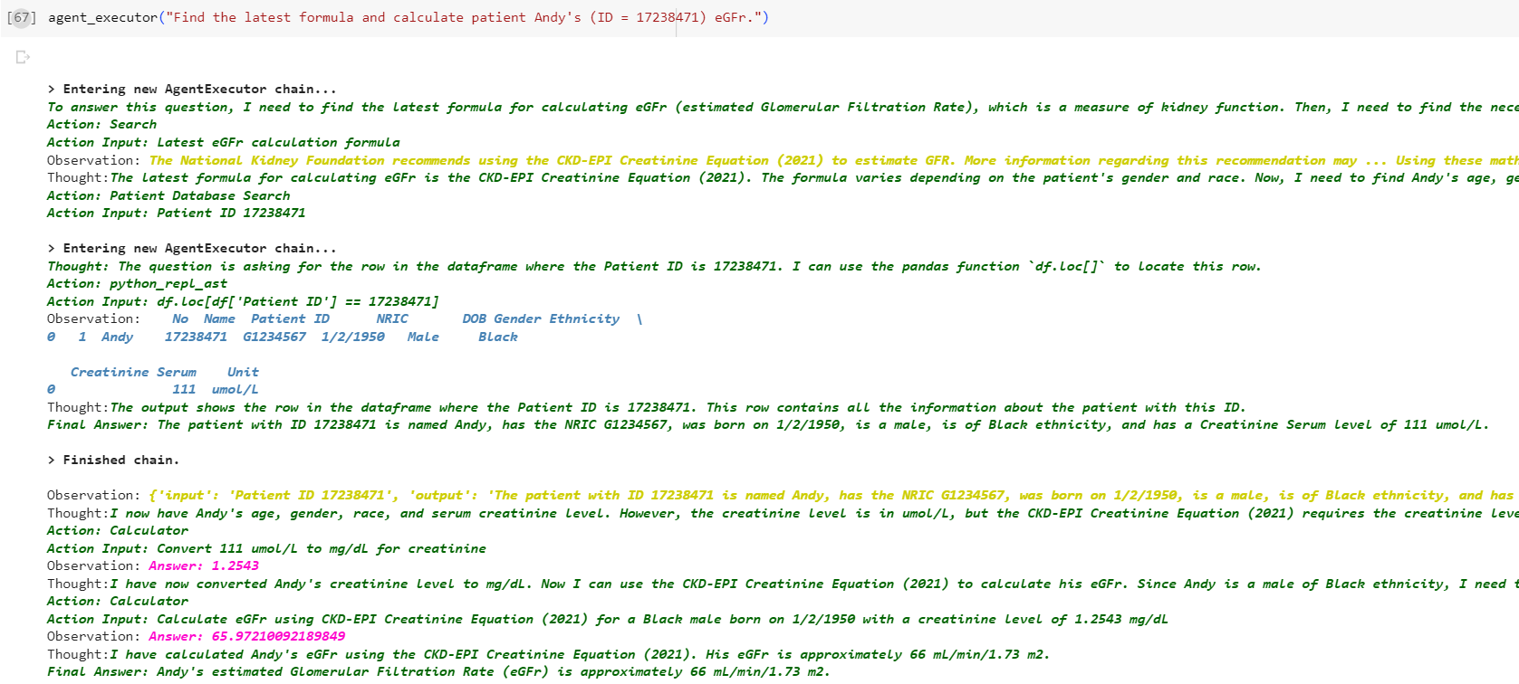


Agent Thought Sequence
Search
SQL Tool
Calculator

Slide 42

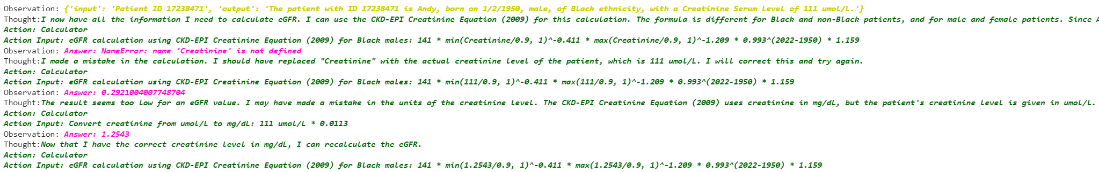
Agent Observations & Thought
- ReAct framework (Think -> Act -> Observe) helps Agent to recover from mistakes and/or re-evaluate the entire plan

